Slide 1
REQUEST LETTER

Slide 2
Writing a Request Letter
A request letter is written on any occasion when someone wants to politely ask for information, a favor or permission for a particular matter. It is an official document that shows the intention of requesting something like a document, details, permission or assistance. It is written by an individual or entity.
Such a letter is addressed to a person or the relevant authority in an institution, company or entity.

Slide 3
Writing a Request Letter
A request letter is important to politely express the legitimate demands that one would like to be met by the reader. This letter enables one to air their views, grievances, or requests in writing.
A request letter can be used as a document for reference in the future. One can also use this letter to request for an adjustment or changes to correct a situation.

Slide 4
Tips
1. Explain precisely what your request is.
2. Mention the reason for the request.
3. Use polite language and a professional tone.
4. Demonstrate respect and gratitude to the reader.
5. The content of the letter should be official.
6. You may provide contact information where you can be reached.
7. You can refer to particular rules, guidelines or policies.
8. Enclose documents to support your request if applicable.
9. Be brief and straightforward.

Slide 5
Sample Letter
Dear Mr. Ramos,
My name is Alyson Osborn a new employee in the dispatch department with Kevian Industries. I hereby write this letter to bring to your kind attention that I have not received my salary for the past two months.
I started working in your company on 1 September 2019 and I was put on probation for three months. According to my contract letter, it is clearly stated that my salary would be started after the successful completion of the probation period. Please find the contract letter attached herewith for your reference. I wish to request for my January and February salary.
Kindly take up this matter with the relevant department so that I can receive my salary. I depend on the salary for all my needs and this delay is constraining me financially. Please address this matter with urgency and resolve this issue at your earliest.

Slide 6
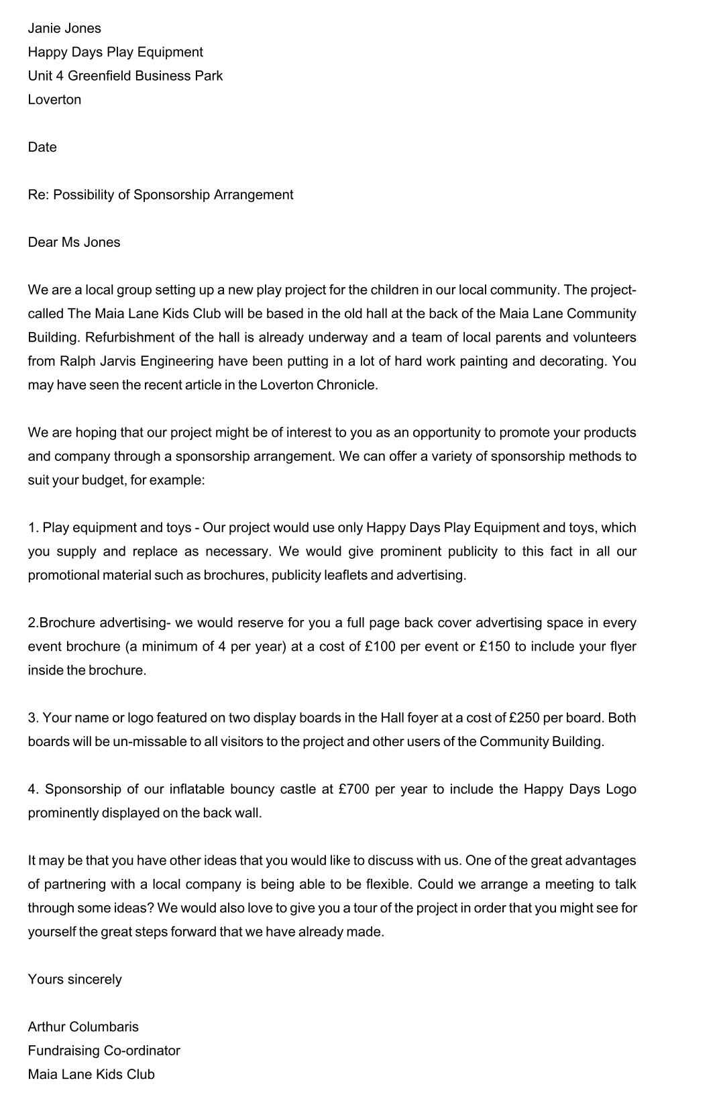
Request letter For Fundraising

Slide 7
Order Placement Letter

Slide 8
Writing Order Placement Letters
An order is a request for something to be made, supplied, or served. Some companies have their own printed forms for placing orders. These forms are pre-numbered for easy reference.
The printed details ensure that no important information is missed out. However, small-scale companies do not use printed forms and place orders by writing letters.
An order placement letter should be written very clearly and accurately, including the complete description of the goods required, quantities, price, catalogue number, delivery requirements, and the terms of payment as agreed by both the parties.

Slide 9
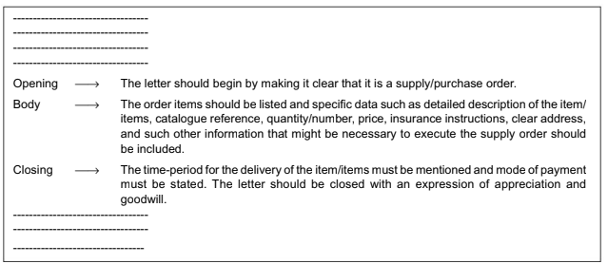

Slide 10
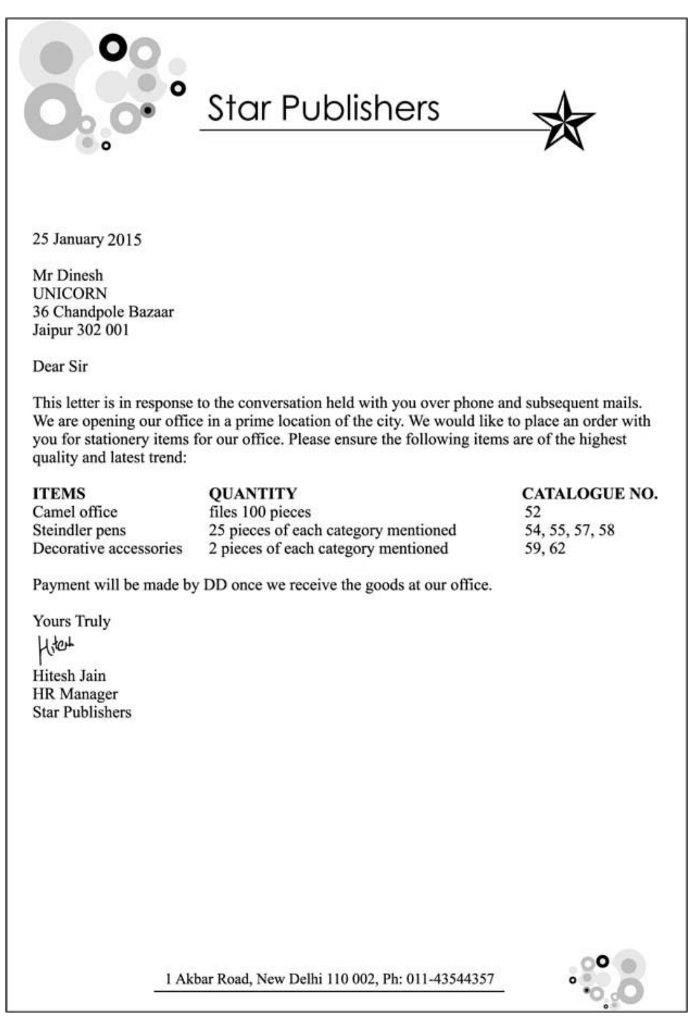
Sample

Slide 11
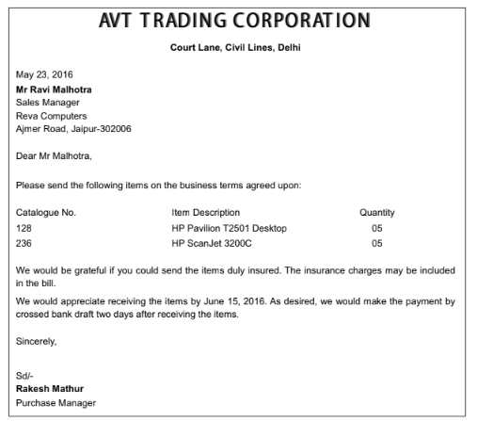

Slide 12
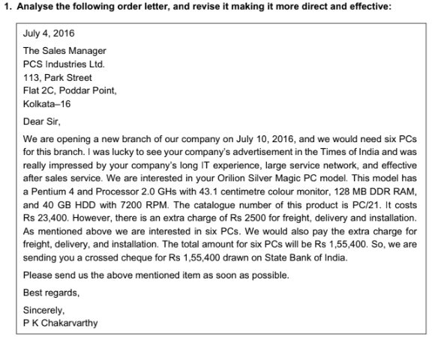

Slide 13
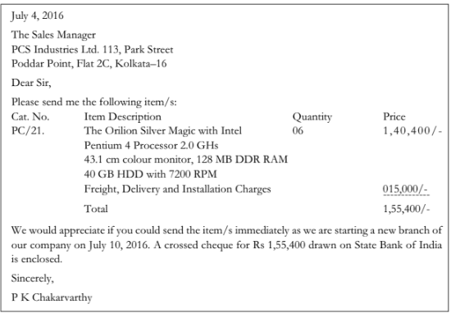

Slide 14
Sales Letter

Slide 15
Sales Letters
Sales letters are the most cost-effective and time-efficient means of marketing products or services. They are also a form of advertising. However, unlike press and television advertising, which are meant for everybody, sales letters are targeted at selected types of customers.
The primary objective of any sales letter is to convert its readers into potential customers.
Before drafting a sales letter one must gain a thorough understanding of the product or service. If it is a product, we must be aware of the following details:
• Appearance • Manufacturing• Working • Packaging • Price • Discount offers

Slide 16
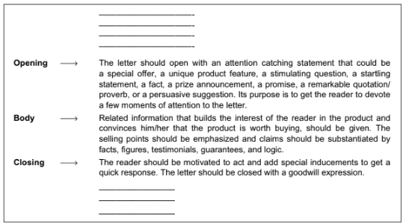

Slide 17
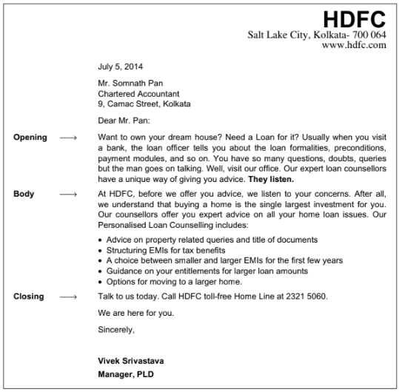

Slide 18
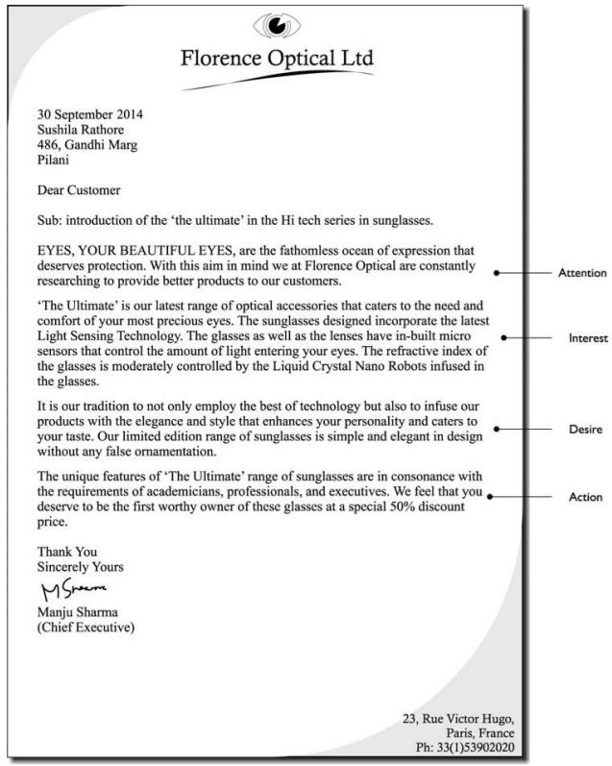
Sample

Slide 19
PART A: Strategies to Capture the Reader’s Attention in Sales Letters
PART B: Some Openings of Sales Letters
(a) Think smart. Buy now. Buying a Maruti Suzuki right now makes more sense than ever.
(b) Today, our happy family of over 24 lakh policy holders is enjoying the unmatched
benefits offered by PLI schemes.
(c) Get a free LG microwave with LG Health Zone air conditioners. Add to that a range of
attractive offers, and you have a great opportunity to make your home a complete
health zone.
(d) Oxyrich Shirts have been designed to release energy giving oxygen ions in high
pressure situations like meetings, traffic jams, and crowded places. To keep you
charged and focused. All day.
(e) Are you thinking of a career in Business Management? IIBS has the answers.
(f) Now look up to global education standards and turn your vision into reality.
(g) Our expert loan counsellors have a unique way of giving you advice. They listen.
(h) Buy any LG product. Win prizes worth over ` 50 crores.
(i) Every cloud has a silver lining.
(j) Be a proud owner of a Hilkon air conditioner designed for your room on your budget.
1. Special Offers
2. Product Features
3. Questions
4. Startling Statements
5. Facts
6. Special Appeal
7. Prize Announcements
8. Promises
9. Quotations/Proverbs
10. Persuasive Suggestions

Slide 20
Answer Key
(a) Persuasive suggestion
(b) Fact
(c) Special Offer
(d) Product Features
(e) Question
(f) Promises
(g) Startling Statement
(h) Prize announcement
(i) Proverb
(j) Special appeal

Slide 21
Resignation Letter

Slide 22
What is a resignation letter?
A resignation letter is an official document that records the end of your employment with an organisation that should come after you’ve indicated your decision to leave in person or via email.
It is always best to speak directly with your manager before sending a resignation letter to give them as much time as possible to prepare.
If you work remotely or do not see your manager in person, ask if you can have a conversation by video chat or on the phone.

Slide 23
Importance of Resignation Letter
It is a matter of professional courtesy to submit a resignation letter.
Resignation letters are also important for HR departments to keep on hand as a record of your time at the company for things like payroll and to reference in the future,
They are also important because they contain important operational information for your direct manager like your last day and what is needed as you plan your departure from the company.

Slide 24
A resignation letter includes the following information:
Statement of resignation from company
Date of last day of work
Statement of gratitude
Next steps or important information
Signature

Slide 25
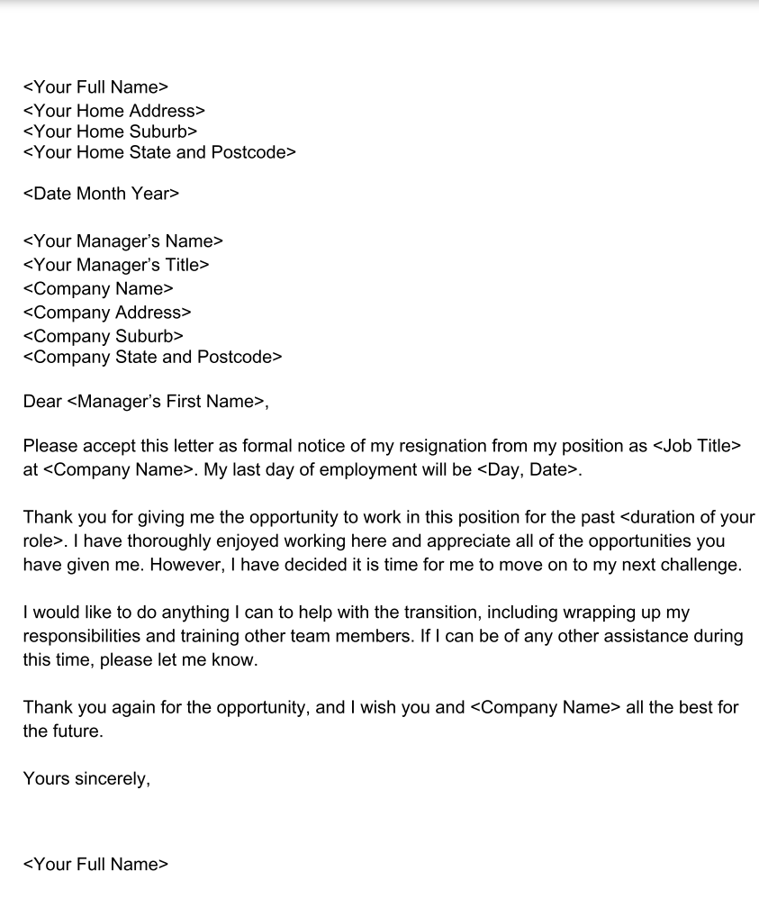
Sample

